Slide 1

Bank Customer Churn Analysis
Using Python Data Analytics
A data-driven approach to identify customers likely to leave the bank and develop strategic retention initiatives
Prepared By: Chinta Bhavana Data Analyst

Slide 2

Business Understanding
Banks depend on long-term customer relationships for stable revenue.
When customers leave (churn) the bank loses income and must spend more to attract new customers.
Understanding churn is important because it helps the bank figure out which customers are at risk and why they are leaving.
To solve this problem the bank wants to understand
Who is leaving? (age group, geography, customer type)
Why are they leaving? (low balance, credit score, activity level, product usage)
What factors predict churn?
How can the bank reduce churn?
Outcome:
Clear insights that help the bank improve customer satisfaction retain more customers and increase long-term profitability.

Slide 3

Dataset Information
Columns Names
Row Number
Customer Id
Surname
Credit Score
Geography
Gender
Age
Tenure
Balance
Number of Products
Has Credit Score
Is Active Members
Estimated Salary
Exited
10K
14
Customer Records
Feature Columns
Strong foundation for understanding churn behavior patterns
Demographics, account details, activity status, and churn indicators
These columns help identify patterns that influence whether a customer stays with or leaves the bank.

Slide 4






Methodology:
[Data Collection] → [Data Cleaning] → [Data Preparation] → [Exploration] → [Visualization] → [Insights]
Data Collection
Imported bank customer dataset into Python using Pandas library
Data Cleaning
Removed duplicates, checked missing values, corrected data types for consistency
Data Preparation
Selected useful features, handled categorical variables, prepared for analysis
Data Exploration
Performed statistical summaries and explored distributions of key metrics
Visualization
Created bar plots, histograms, and correlation heatmaps using Matplotlib and Seaborn
Insights
Identified key patterns and factors influencing customer churn for strategic decisions

Slide 5
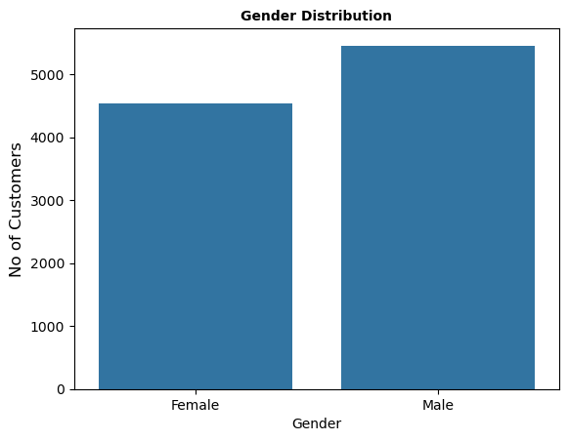
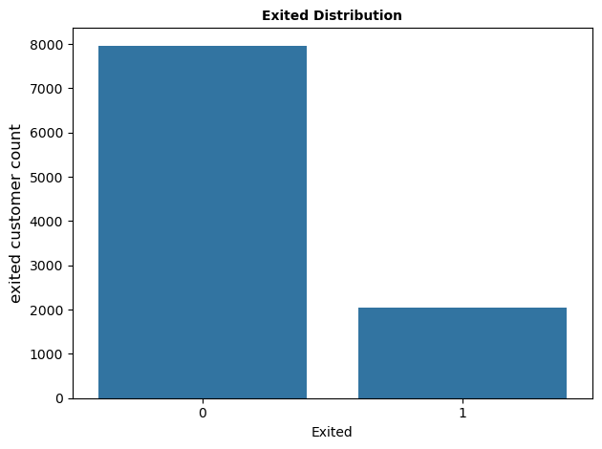
Visualizations
Gender Distribution
Churn Distribution
The customer base shows a relatively balanced gender split with 5,457 males (54.6%) and 4,543 females (45.4%) across all 10,000 observations.
Overall 7,963 customers (79.6%) remained with the bank while 2,037 customers (20.4%) exited—establishing our baseline churn rate.

Slide 6
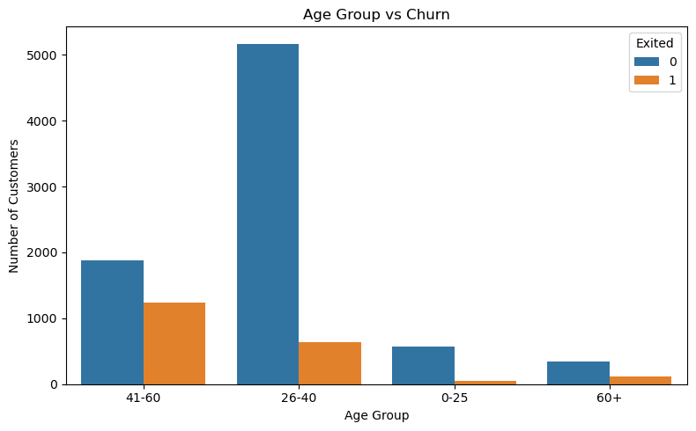
Age Impact on Churn
Age Group | Stay (0) | Exited (1) | Churn %
0-25 | 565 | 46 | 7.5%
26-40 | 5,168 | 640 | 11.0%
41-60 | 1,881 | 1,236 | 39.6%
60+ | 349 | 115 | 24.8%
Observation: Age 41–60 has the highest exit rate (39.6%) and contributes the most to total churn. Younger customers (especially under 25) are much more likely to stay.

Slide 7
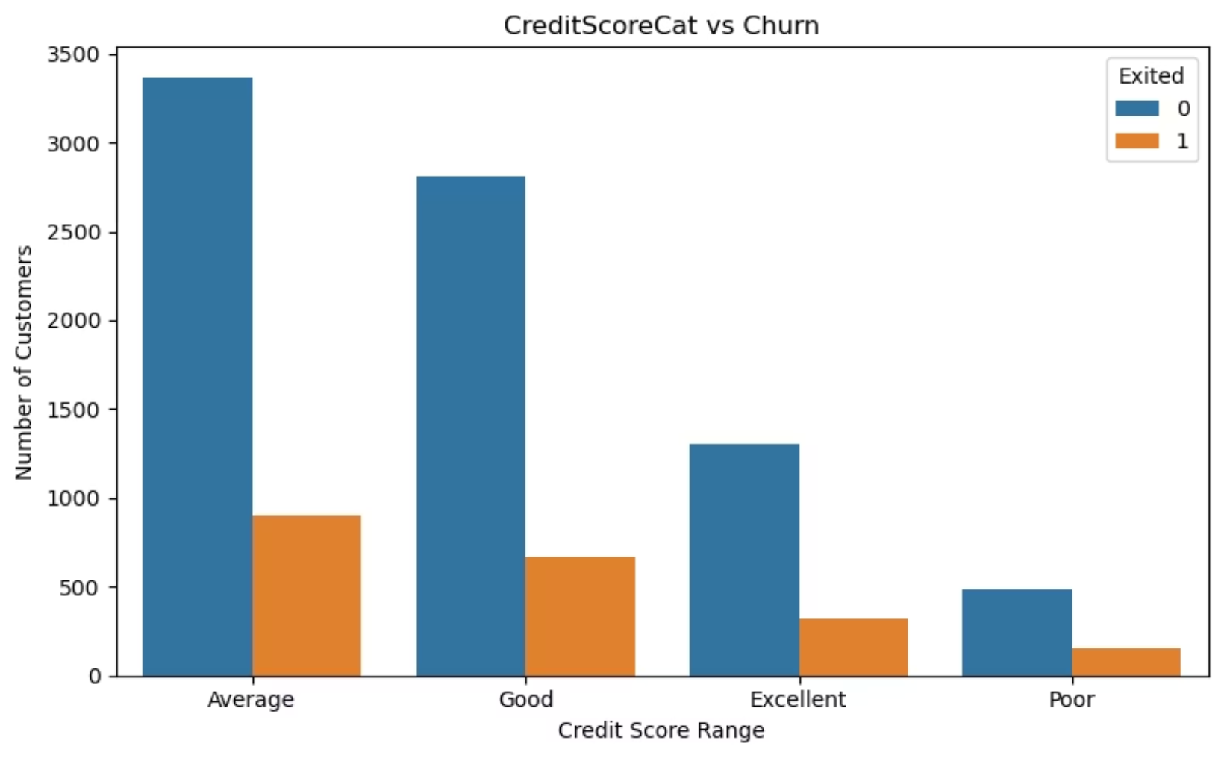
Credit Score Impact on Retention
Credit Category | Retained | Exited | Churn Rate
Poor | 482 | 150 | 23.7%
Average | 3,369 | 899 | 21.1%
Good | 2,810 | 667 | 19.2%
Excellent | 1,302 | 321 | 19.8%
Observation: Average credit segment loses most customers—899 exits (44% of total churn). Poor credit customers show highest churn rate at 23.7%.

Slide 8
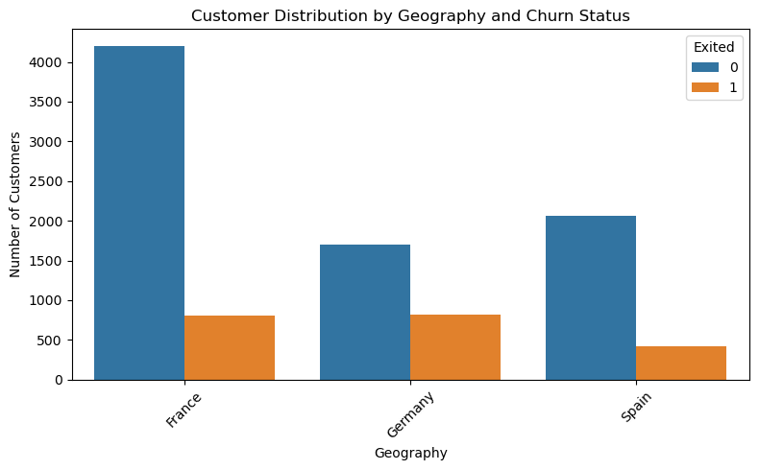
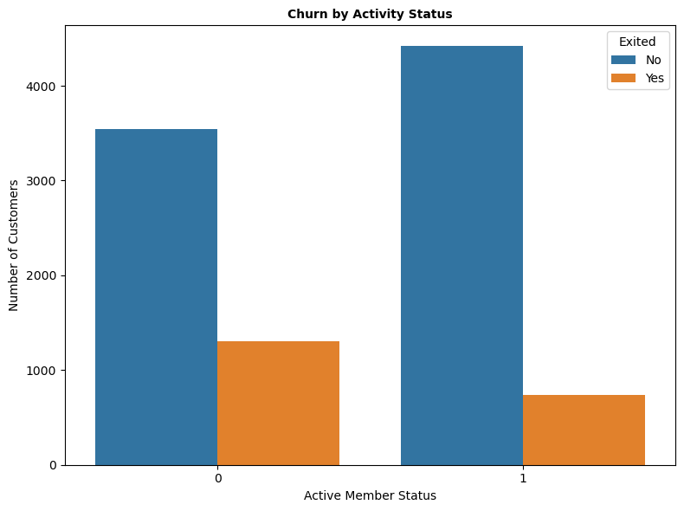
Geography Drives Risk
Active Members
Germany: 32.4% churn rate—highest risk market
3,547 Stay (0)vs only 462 Exited(1)
Spain: 16.7% churn rate
13% churn rate
Inactive Members Retained: Only 1,302 customers
France: 16.1% churn rate—lowest but still significant

Slide 9
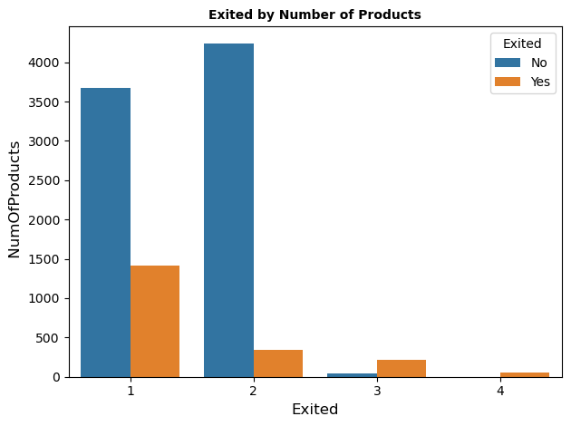
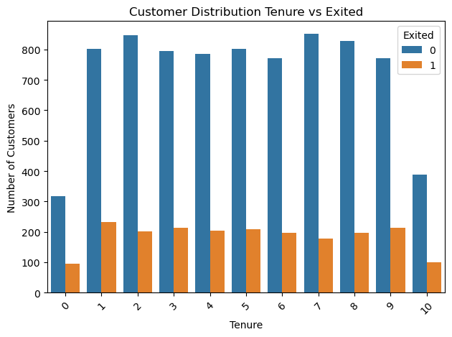
46%
Tenure Risk Zones
1Products : Balanced retention
Years 0-2: 77-80% exit rate during o boarding phase
80%
2 Products: Exit rate jump to 80% (1,409 exited(1) vs 348 stay(0).
Years 3-7: Peak churn at 83% (year 7) signals mid-relationship challenges
4Products : 100% exit (46 vs 0)—total failure.
79%
Years 8-10: Sustained 75-79% attrition contradicts loyalty expectations
3 Products: 79% exit (220 vs 60).
100%

Slide 10
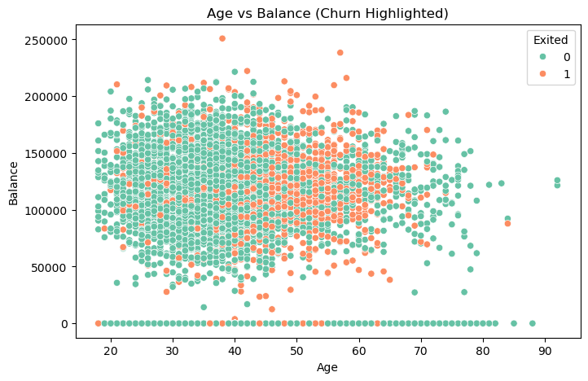
Financial Impact
44.8
£91K
£18K
Average Age of Churners
vs 37.4 years for retained customers
Average Balance of Churners
vs £72,745 for retained customer
Balance Loss Per Churned Customer
High-value client attrition
Actionable Insight: Prioritize retention campaigns for 40+ customers with >£80k balances via premium perks or personalized outreach

Slide 11
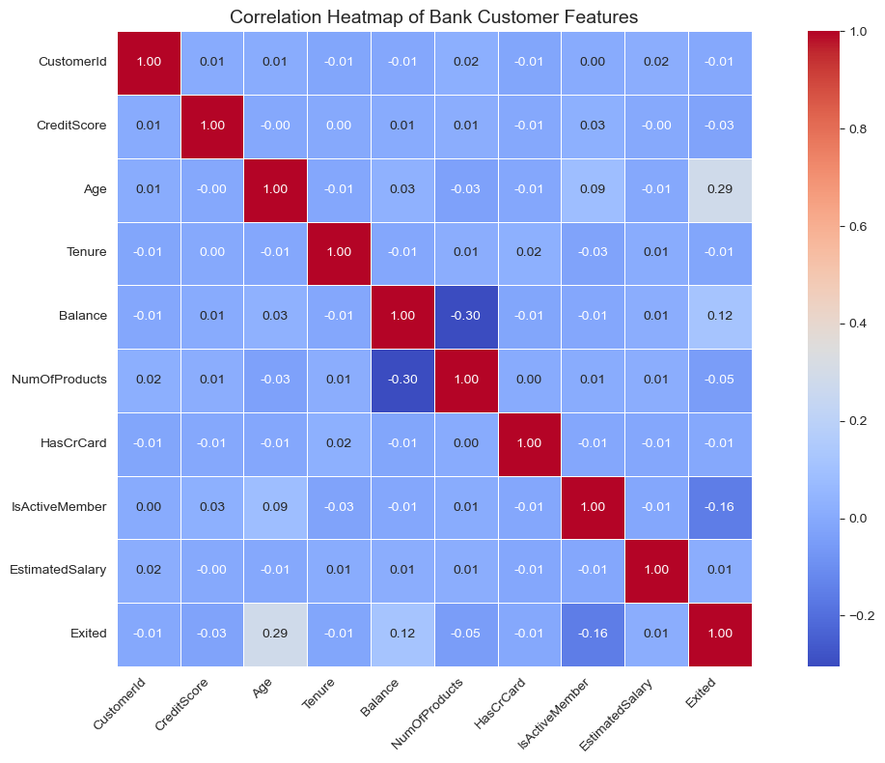
Correlation Analysis: Age, Number of Products, and Balance show clear positive correlation with churn. Active members have lower churn rates. Credit Score, Salary, and Tenure show very weak correlation with churn.

Slide 12

Conclusion :
Key Findings
Customer churn is mainly influenced by demographics, account activity, tenure, and credit profile
Targeted Actions
Personalized offers loyalty programs and improved engagement for high-risk segments
Future Improvements
Using more data and advanced models can further improve churn prediction and management
Business Impact
Increase customer loyalty and overall profitability through data-driven retention strategies

Slide 13

Thank you!
“The Ultimate Guide to a Powerful closing”

